Slide 1









SERINIBOT
YOUR CARING MENTAL HEALTH COMPANION
“AI‑POWERED, EMPATHETIC SUPPORT AT YOUR FINGERTIPS”
BY ABHIK GHOSH
E23CSEU0504
B17

Slide 2





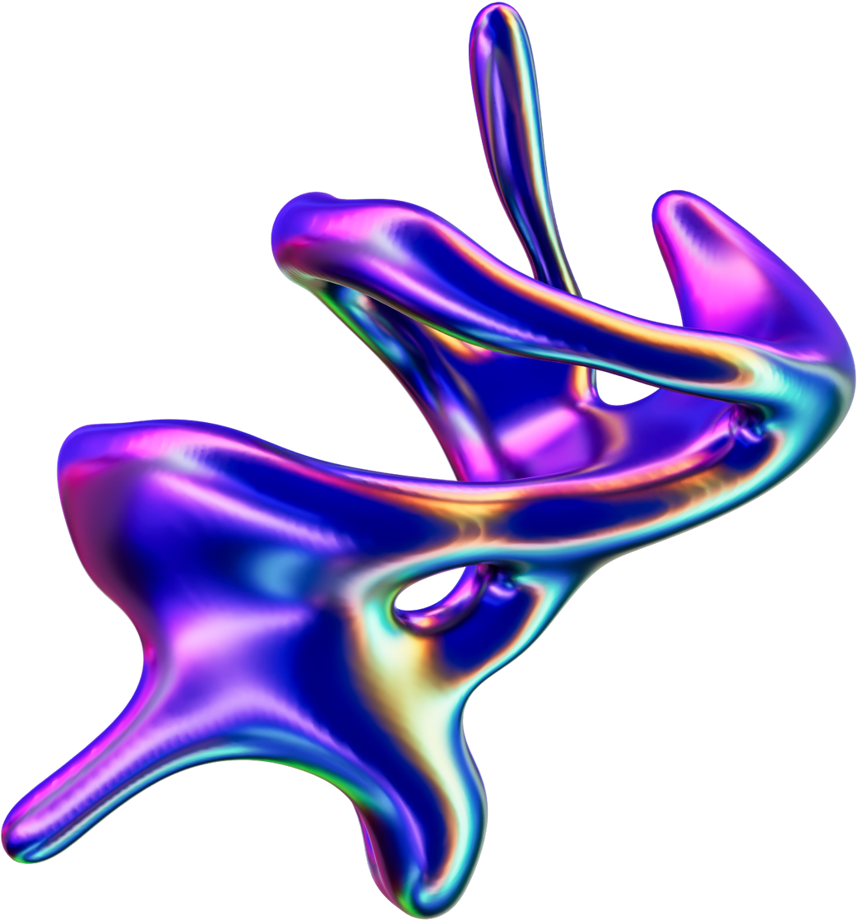


PROBLEM & MOTIVATION
Depression remains one of the world’s most pervasive mental health disorders, impacting hundreds of millions of people. Many individuals face significant barriers—such as social stigma, high costs of therapy, and geographic isolation—that prevent them from seeking professional help. SeriniBot was born out of the need for a scalable, accessible solution that can offer immediate, judgment‑free support through a friendly conversational interface.

Slide 3
MEET SERINIBOT
SeriniBot is a web‑based chatbot that listens to user messages, analyzes the emotional tone of the text, and responds with comforting, context‑aware guidance. Behind the scenes, advanced Natural Language Processing (NLP) models detect linguistic patterns indicative of low mood or depressive language. The system runs on a FastAPI backend for high‑performance inference, allowing users to receive feedback in real time from anywhere with an internet connection.
Easy to USE
AI POWERED
A fimiliar chatbot type user interface makes it easy to use and approachable for those in need.
Serinibot listens, analyzes, and responds with empathy by leveraging NLP + deep learning to detect depression cues in text

Slide 4
IMPACT & VISION
SeriniBot is poised to serve as a frontline support tool in university counseling centers and remote clinics, reaching individuals who might otherwise fall through the cracks. Its anonymous nature makes it easy to recommend for those reluctant to seek help and hopes to create a initial diagnosis to help affected individuals effectievly seek any help necessary.

Slide 5
KEY FEATURES
SeriniBot combines the latest transformer‑based language models with a privacy‑first approach to deliver empathetic interactions. Every conversation is anonymized: no personally identifying information is stored, and all processing happens over secure, encrypted channels.
01
02
03
Real‑time Analysis
Ease of use
Privacy first
Designed to be approachable and easy to use by utilizing simple yet elegant chat user interface
All data anonymized and handled securely assuring the user that all inputs made remain 100% anonymous
Instant sentiment detection from simple questions

Slide 6
SYSTEM ARCHITECTURE

Slide 7
MAJOR STEPS IN DEVELOPMENT
Data & Preprocessing
Model Training and evaluation
Inference API & Frontend
Data & Preprocessing module cleans and tokenizes incoming text, converting it into the numerical inputs that power the model.
the Model Training Pipeline, built with PyTorch Lightning, trains and fine‑tunes a DistilRoBERTa‑based classifier, complete with learning‑rate scheduling and mixed precision for efficiency.
Finally, the Inference API, implemented in FastAPI, exposes endpoints that the front‑end chatbot calls to analyze user messages and return responses instantly.

Slide 8
MODEL ARCHITECTURE
Encoder
Classifier
Loss Function and Optimizer
Hyperparamters
Two Dense Fully Connected Neural Network Layers with a softmax activation function for binary classification
CrossEntropy was used due to encoded output of encoder and AdamW Optimizer was used for backpropogation
initialized training with an AdamW optimizer at a learning rate of 2×10⁻⁵, pairing it with a linear learning‑rate scheduler that warms up for the first 10 percent of total steps. Dropout layers intrinsic to the transformer blocks provide regularization.
6‑layer DistilRoBERTa (66M params) Transformer Model

Slide 9
TRAINING RESULTS
After training, SeriniBot’s model achieved a validation accuracy of 94.87 percent and a training accuracy of 93.85 percent, demonstrating strong generalization from the training set to unseen data.By fine‑tuning a DistilRoBERTa backbone, we harnessed transfer learning to converge rapidly to high accuracy within a single pass over the data.
That the validation accuracy slightly exceeded training accuracy suggests that regularization techniques and the inherent noise in dropout layers helped the model avoid overfitting. These metrics indicate that SeriniBot reliably distinguishes between depressive and non‑depressive text across a diverse set of user‑generated messages.

Slide 10
SNIPPETS

Slide 11
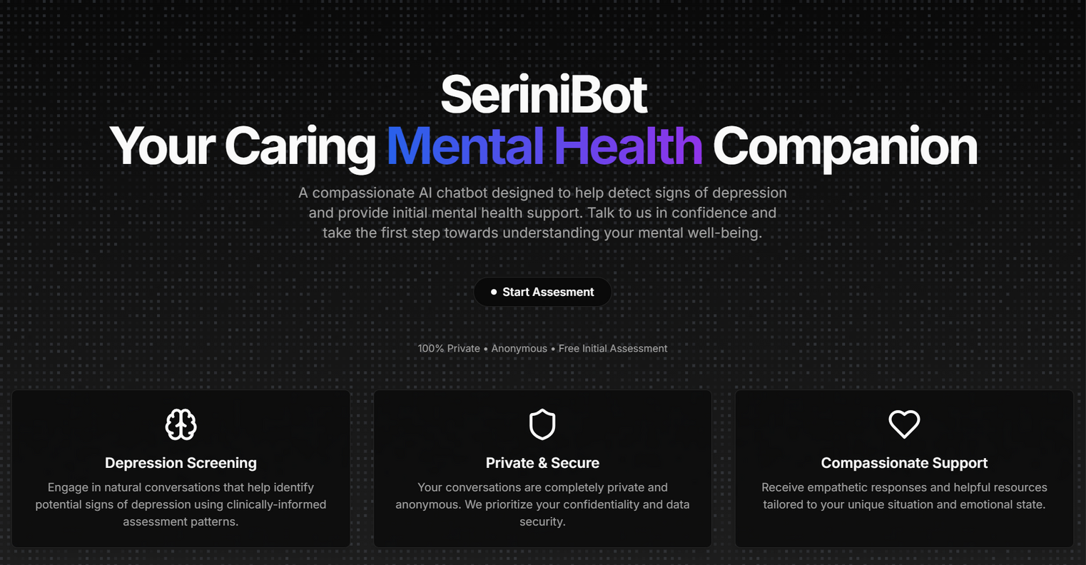
LANDING PAGE

Slide 12
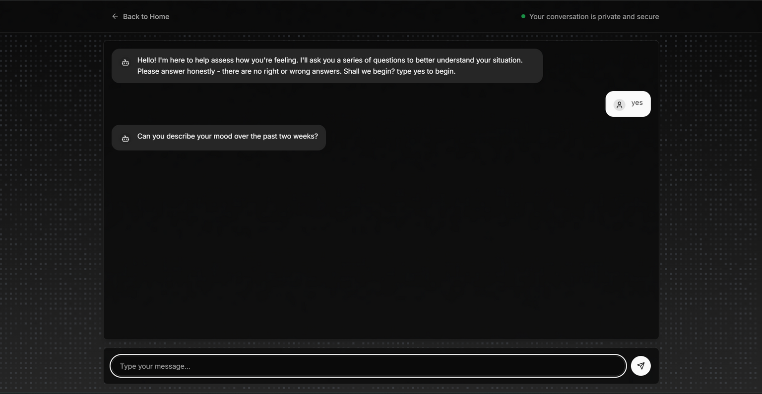
CHAT INTERFACE

Slide 13
FUTURE WORK
Expanded and Diverse Data Collection
Multimodal and Contextual Understanding
Curate Multilingual Corpora
Include Conversational Variants
Augment Low‑Resource Categories
Text alone can be limiting, especially when nonverbal cues carry significant emotional content. Future expansions include:
Voice Sentiment Analysis
Image‑Based Emotion Recognition
Ecosystem Integration and Professional Alignment
Real‑World Validation and User Feedback
To bridge the gap between AI support and professional care, SeriniBot will integrate with external systems:
Electronic Health Records (EHR)
Telehealth Referral Workflows
Compliance and Privacy
Beyond offline benchmarks, SeriniBot must prove its value in live settings. We will:
Pilot Studies with Partner Clinics
Continuous Learning Loop

Slide 14
THANK YOU
BY ABHIK GHOSH
E23CSEU0504
B17

